Slide 1
Auditing Data Provenance in Text-generation Models
Congzheng Song Vitaly Shmatikov
Cornell University/Cornell Tech

Slide 2
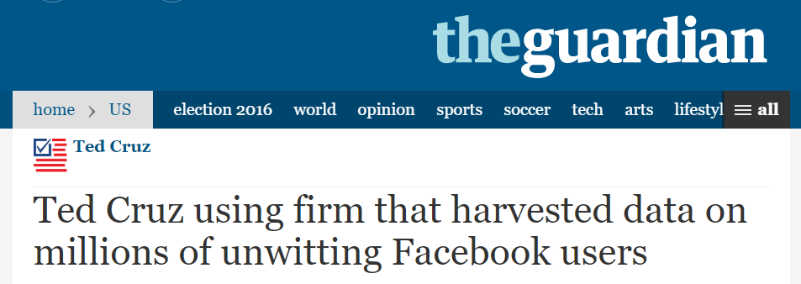
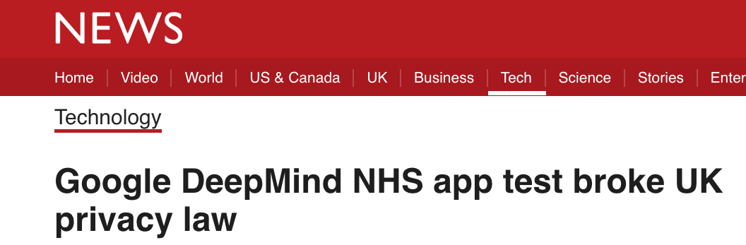
ML Models Trained on Sensitive Data
Sensitive personal data are used to train ML models
Your data may be used without your consent!
VIOLATE
Gives you the right to know how your data is processed

Slide 3
Need to Audit Data Provenance
Auditing data provenance
Was my data used for training the model?
Target ML model trained on multiple users’ data
Auditing data provenance =
distinguishing training data and "unseen" data
Membership inference
[Shkori et al, 2017]

Slide 4
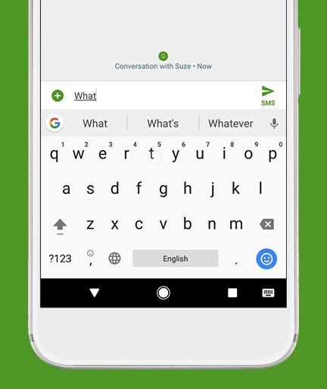
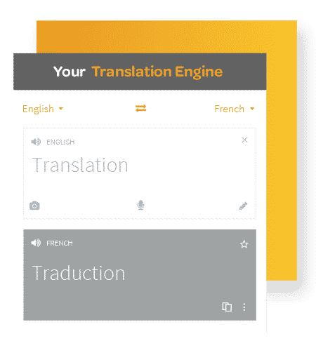
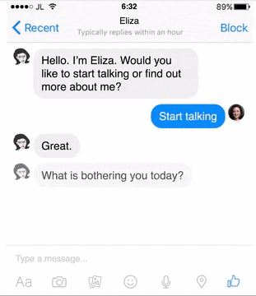
Text-generation Models
Next-word prediction
Machine translation
Dialogue generation
Trained on personal data, including
messages, documents, chats, comments, and search queries

Slide 5
Text-generation Models
Generate one word at a time with RNN
Output distribution over vocabulary
rarely
drink
beer
<EOS>
rarely
am
did
…
I
they
…
RNN
RNN
RNN
RNN
Ranked words ordered by probability
I
rarely
drink
beer

Slide 6
Word Prediction in Text-generation Models
Observation:
model assigns much higher rank to rare words when appear in training texts v.s. in unseen texts
rarely
rarely
am
did
…
I
they
…
RNN
Signal for distinguishing training data and unseen data
Ranked words ordered by probability
I

Slide 7
Word Prediction in Text-generation Models
Histogram of ranks
Training texts
Predicted rank
I rarely drink beer
Target model
rarely | 1
drink | 10
beer | 32
Distinguishable
difference!
Unseen texts
I often drink soda
often | 2
drink | 123
soda | 213
How to infer whether my data was used for training the model?
Use supervised learning!

Slide 8
Auditing with Supervised Learning
Train
Shadow model
Data to be audited
IN
Target model
Unseen
OUT
…
…
Audit Model
Train
Shadow model
IN
Unseen
Was my data used for training target model?
OUT

Slide 9
Evaluation
Next-word prediction
Reddit dataset, LSTM
Machine translation
Annotated TED talks, sequence-to-sequence with LSTMs and attention
Dialog generation
Cornell movie dialog corpus, sequence-to-sequence LSTMs
All data are splited by users
Shadow models trained on disjoint (cross-domain) datasets

Slide 10
Results
Perfect precision and recall on all tasks!
* assuming the model outputs ranks for the entire vocabulary

Slide 11
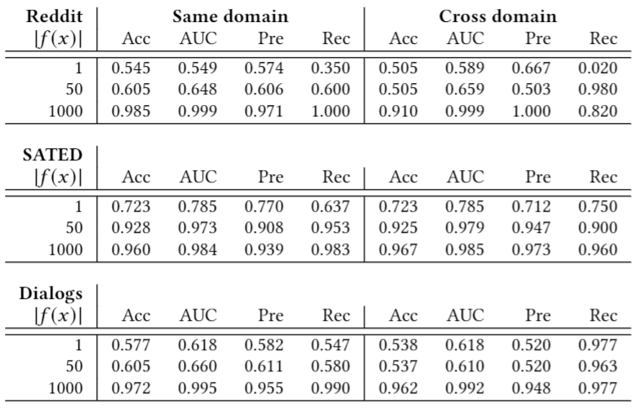
Restricted Model Outputs
Even if the translation model outputs a single word, auditing works with reasonable accuracy
Interpretation: translation models really memorize their training sequences

Slide 12
Rare words are better
A single query is enough for accurate auditing if it includes relatively rare words
Notes:
Also varying the number of data to query the model for each user. Submit either randomly or submit the rarest text first.

Slide 13
Root cause: Overfitting?
Dataset | Train accuracy | Test accuracy | Train perplexity | Test perplexity
Reddit | 18.4 | 20.6 | 102.22 | 113.14
SATED | 58.7 | 53.5 | 6.36 | 10.28
Dialogs | 28.3 | 26.4 | 45.57 | 61.11
Small train-test gap
Small train-test gap

Slide 14
Memorization in Text-Generation Models
90% of data are top 20% words
Models assign much higher rank to less frequent words when they appear in training sequences

Slide 15
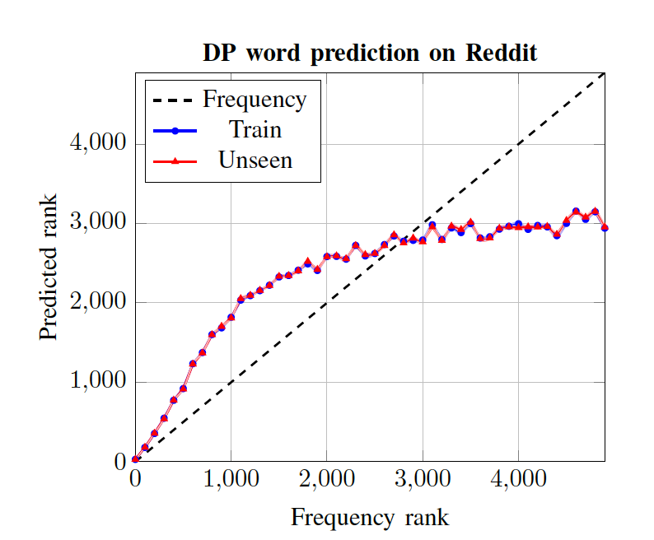
Countermeasure: Differential Privacy
[McMahan et al, 2018]
DP bounds the difference between model output on training texts and unseen texts
Auditing fails but ...
model never predicts rare words

Slide 16
Thank You! Code available at https://github.com/csong27/auditing-text-generation
Takeaways
Text-generation models memorize training texts
Models assign higher rank to rare words that appear in training texts
Memorization enables effective auditing of data provenance

